Slide 2
Ride for the Brand
Notes:
Facilitator:
If this is the first-time participants are hearing about the Doc B Leadership Academy introduce the Academy. This is a great opportunity to build the “why” behind the “what” of leadership development based on the philosophies and values of Clovis Unified ( script available in resource folder). If this is not the first time briefly review the purpose of the Leadership Academy.

Slide 3
Part III
Notes:
Facilitator:
Part III of each module uses outside resources that reflect the philosophy and values we are studying. It is a deep dive into our philosophies and values; where they originated, why its important today, and what it looks like in action. For the ride for the brand philosophy, we are using a video from John Maxwell and his book 5 Levels of Leadership. A summary is available in the resource folder.

Slide 4
Notes:
Script for Tier III
Facilitator:
In the video we are going to watch you are going to hear Dr. Kaiser talk about a time in our district when our philosophies, beliefs, and values were tested. He explains a time when Clovis leaders had to do what was best for the organization, no matter their loyalty to an individual. It was a “tough time” for leaders across the district. Dr. Kaiser has been described as the epitome of riding for the brand. Dan started at Clovis High School as an English teacher and coach. A little-known fact is that Dan was inducted into the Clovis Unified Hall of Fame, receiving the Doc Buchanan Award. At one time Dan held the world’s sixth fastest time in the 110 high hurdles.
Facilitator:
Before we watch the video jot down a couple beliefs about riding for the brand. As we listen to the video record statements that reflect your own beliefs.
Watch the video
Ask for volunteers to share some of the statements they recorded and explain why it resonates with them.
Or
What are some key-take aways from the video?
Go on to next slide.

Slide 5
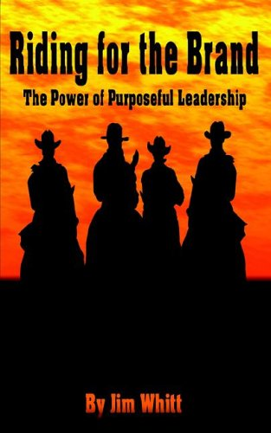
Part III
Do we still ride for the brand?
Notes:
Script: Tier III
Facilitator:
You heard Dr. Dan Kaiser talk about how administrators who remained after Doc’s departure used the book Riding for the Brand at a CHARGE session to help everybody understand what happened during a turbulent time in our history. Our goal was to learn from the past and renew and reaffirm CUSD core philosophies.
We were also reading books on Leadership by John Maxwell. Read Maxwell’s quote on the screen. Think about the role of a leader and how this quote applies to riding for the brand, especially in difficult times. Turn to you neighbor and share your thoughts. Ask for volunteers to share with the group. Facilitator should model.
Discussion Points:
In a group of three discuss one or more of the following:
101 – In the video Dr. Kaiser discussed a Governing Board that removed Dr. Buchanan (his contract was not renewed). The Board then hired a Superintendent whom they directed to remove Leaders who believed in the CUSD system. Discuss the beliefs, values, and standards that make up the CUSD system. Choose one and discuss why it is important to the overall educational experience of a student.
201 – In the video Dr. Kaiser talked about a Superintendent who had violated the standards of Clovis Unified and was removed. The announcement was made in front of the entire leadership team, which clapped. He described that as the first time of feeling “we ride for the brand and the brand is bigger than any one person”. Identify and discuss the lessons learned from this moment in our history.
301 – Using the notes you made before and during the video come to a consensus on a definition of riding for the brand to share with other participants.
Ask groups to share their responses.

Slide 6
Maxwell on Leadership
Notes:
Script: Tier I, II, III
Facilitator:
We are going to spend about 12 minutes listening to John Maxwell talk about 5 levels of leadership. Maxwell is considered an authority on Leadership. He has spoken several times in the Fresno/Clovis area and several CUSD employees have participated over the years. Please pay attention to the very end of his talk for today’s activity.
All participants:
List the employees at your school, site, and/or department you consider a leader or has the potential to be a leader. Beside each employee’s name record where on the leadership level you believe this employee would place you. Turn to a neighbor and share one employee (no need to name) and explain your thinking.
Discussion Points:
In small groups discuss one or more of the following (facilitator’s choice):
101 – Why is it important that we know which level we are on with each employee? What ramifications does this have for us, as leaders?
201 – Examine your groupings of employees, are there any patterns? (For instance, all those employed for less than a year are following me simply because of my position).
301 – Thinking about a leader you consider to be a Level 5 leader according to Maxwell. What did or does this leader do for you to believe they are a Level 5 leader?
Ask each group to share their responses with the larger group.

Slide 7
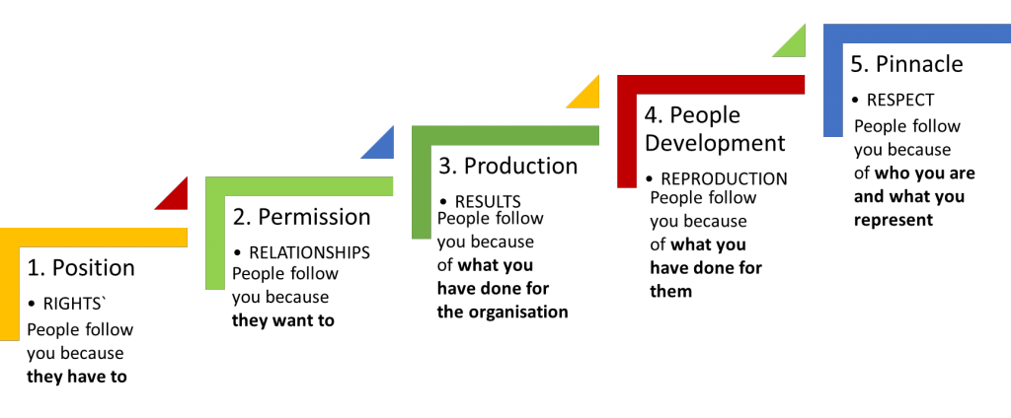
5 Levels of Leadership
Notes:
Script: Tier I, II, III
Facilitator:
An activity discussing various aspects of leadership is included with each CUSD Philosophy. Today’s discussion is around the 5 levels of Leadership as described by John Maxwell in his book 5 Levels of Leadership (summary available in resource folder). According to Maxwell the pinnacle phase of leadership is when people follow you because of who you are and what you represent. Looking at each level of leadership think about yourself or someone you know who represents each step. Ask for volunteers to describe the type of person who might be represented by each level. Possible answers:
Position – someone new to their position. For instance, a new learning director that came from the elementary level in another area.
Permission – someone people know, like, and trust
Production – someone who has been successful in CUSD. Someone who CUSD has benefitted from as a leader.
People Development – your mentor, guide, constructive friend
Respect – someone who represents the best of Clovis Unified, has integrity, honest, etc.
Discussion Point:
Let’s think about ourselves as leaders to answer the following:
101 - Think about yourself as a leader. Where would you place yourself on Maxwell’s leadership progression and why?
201 - What do you need to accomplish to rate yourself as a Level 5 leader with most employees on your site and/or department.
301 - Share your thoughts with a mentor or supervisor asking them for feedback. Take the time to reflect and revise your plan throughout your tenure as an administrator.

